Slide 1
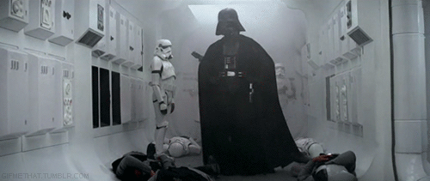
Don’t forget your projectile investigation is due in on Friday 24th October

Slide 2
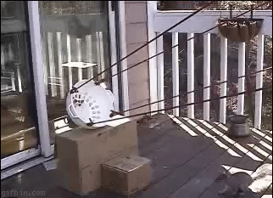
Projectile investigation
Aim
Method
Results
Graph
Conclusion
Evaluation

Slide 3
2.2 Forces

Slide 4
This lesson
Representing forces as vectors
Sketching and interpreting free-body diagrams

Slide 5
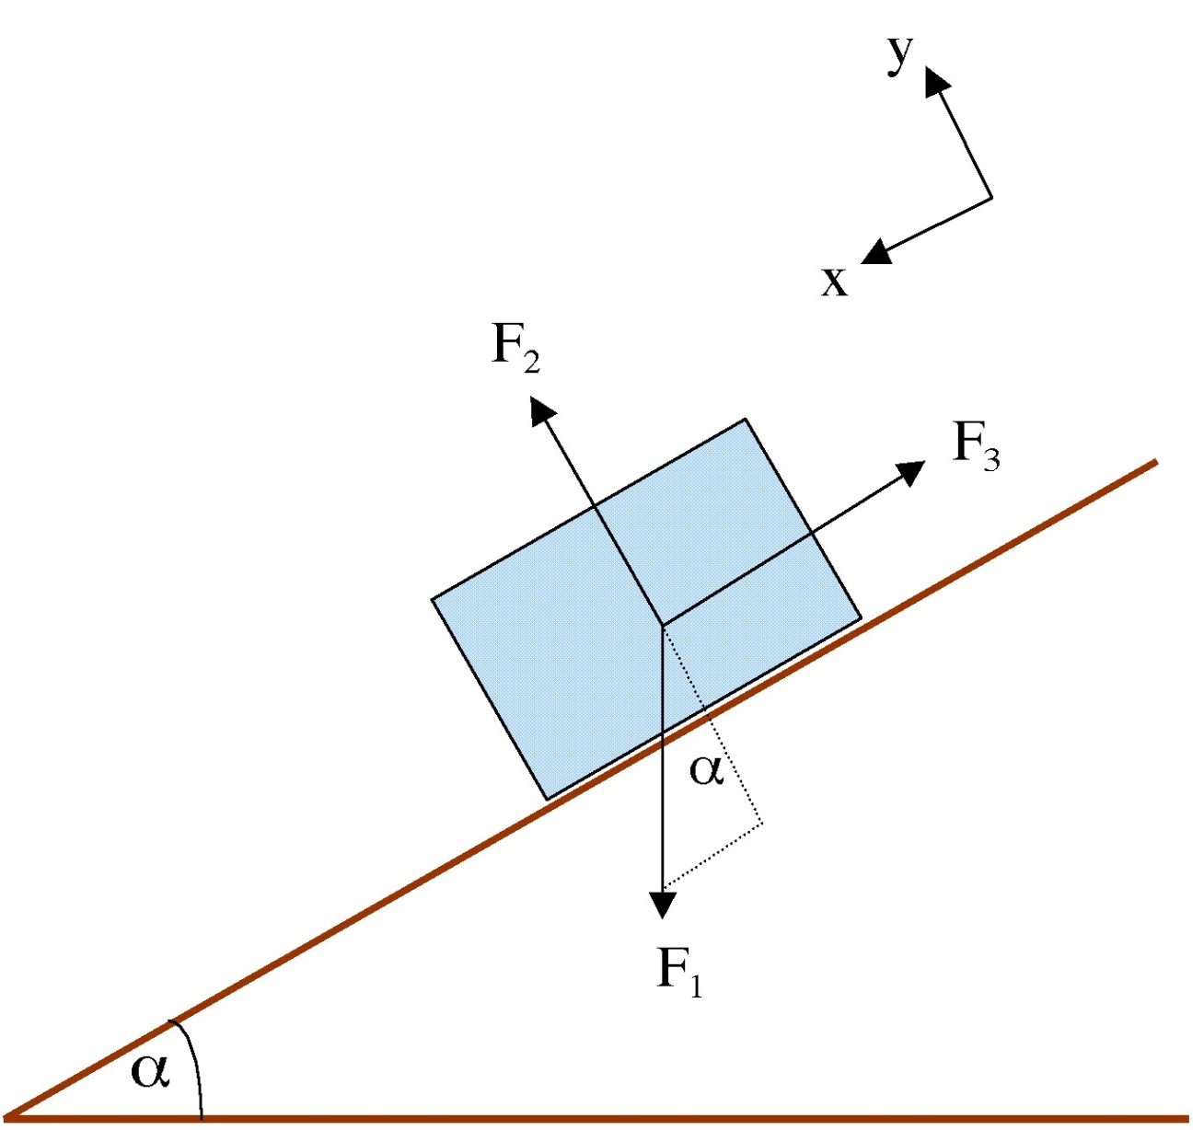
Free-body diagrams

Slide 6
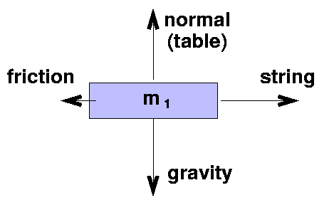
Free-body diagrams
Shows the magnitude and direction of all forces acting on a single body
The diagram shows the body only and the forces acting on it.

Slide 7
Remember!
Forces can be represented by an arrow. The size of the arrow indicates the magnitude of the force, and direction the direction!
When answering a question, you must always mention the direction of the force.

Slide 8
Adding forces
When adding forces it is important to remember they are vectors and their direction needs to be taken into account.
The result of adding two forces is called the resultant or net force.

Slide 9
Examples
Mass hanging on a rope
T (tension in rope)
W (weight)

Slide 10
Examples
If a body touches another body there is a force of reaction or contact force. The force is perpendicular to the body exerting the force
Inclined slope
R (normal reaction force)
F (friction)
W (weight)

Slide 11
If stationary (or constant speed)
Inclined slope
No resultant force
R (normal reaction force)
F (friction)
W (weight)

Slide 12
Components of weight
Components parallel to plane
Friction = Wsinθ
R (normal reaction force)
W (weight)
θ
θ
F (friction)

Slide 13
Components of weight
Components perpendicular to plane
R = Wcosθ
R (normal reaction force)
W (weight)
θ
θ
F (friction)

Slide 14
Examples
String over a pulley
T (tension in rope)
T (tension in rope)
W₁
W₁

Slide 15
Free-body diagrams - video
http://www.youtube.com/watch?v=gDk2te4nrIo

Slide 16
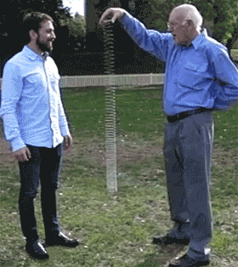
2.2 Free-body diagram worksheet

Slide 17
Free-body diagrams
Go round school.
Sketch 5 free-body diagrams for objects/people you see around school.
You have 20 minutes.

Slide 18
Let’s do some reading!
The Forces and free-body diagram pages in your textbook

Slide 19
This lesson
Describing the consequences of Newton’s 1st law for translational equilibrium
Using Newton’s 2nd law both quantitatively and qualitatively
Identifying force pairs in the context of Newton’s 3rd law
Solving problems involving forces

Slide 20
Newton’s Laws of Motion
That’s me!

Slide 21
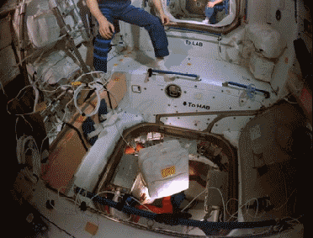
Newton’s 1st Law
An object continues in uniform motion in a straight line or at rest unless a resultant external force acts

Slide 22
Newton’s 1st Law
Does this make sense?
An object continues in uniform motion in a straight line or at rest unless a resultant external force acts

Slide 23
Newton’s 1st law
Newton’s first law was actually discovered by Galileo.
Newton nicked it!

Slide 24
Newton’s first law
Galileo imagined a marble rolling in a very smooth (i.e. no friction) bowl.

Slide 25
Newton’s first law
If you let go of the ball, how far will it roll up the other side of the bowl? Why?

Slide 26
Newton’s first law
If you let go of the ball, it always rolls up the opposite side until it reaches its original height (this actually comes from the conservation of energy).

Slide 27
Newton’s first law
What happens with a longer bowl?

Slide 28
Newton’s first law
It also (assuming no friction!) rolls up to the height it was dropped from.
constant velocity

Slide 29
Newton’s first law
Galileo imagined an infinitely long bowl where the ball never reaches the other side! What happens now?

Slide 30
Newton’s first law
The ball travels with constant velocity until its reaches the other side (which it never does!).
Galileo realised that this was the natural state of objects when no (resultant ) forces act.
constant velocity

Slide 31
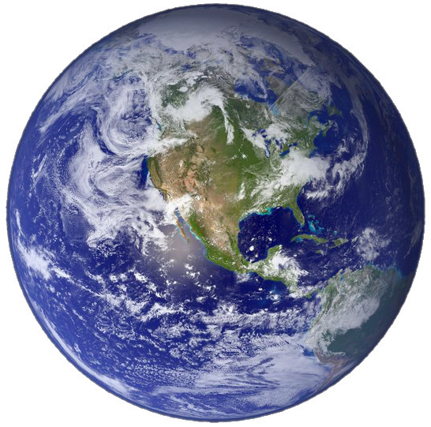
Extension question
What if we take into account the curvature of the earth?

Slide 32
Other examples
Imagine a (giant) dog falling from a tall building

Slide 33
Other examples
Air resistance
To start the dog is travelling slowly. The main force on the dog is gravity, with a little air resistance
gravity

Slide 34
Other examples
As the dog falls faster, the air resistance increases (note that its weight (force of gravity) stays the same)
Air resistance
gravity

Slide 35
Other examples
Eventually the air resistance grows until it equals the force of gravity. At this time the dog travels with constant velocity (called its terminal velocity)
Air resistance
gravity

Slide 36
Oooops!

Slide 37
Another example
Imagine Mr Porter cycling at constant velocity.

Slide 38
Newton’s 1st law
He is providing a pushing force.
Constant velocity

Slide 39
Newton’s 1st law
There is an equal and opposite friction force.
Pushing force
friction
Constant velocity

Slide 40
Newton’s second law
Newton’s second law concerns examples where there is a resultant force.
I thought of this law myself!

Slide 41
Let’s go back to Mr Porter on his bike.
Remember when the forces are balanced (no resultant force) he travels at constant velocity.
Pushing force
friction
Constant velocity

Slide 42
Newton’s 2nd law
Now lets imagine what happens if he pedals faster.
Pushing force
friction

Slide 43
Newton’s 2nd law
His velocity changes (goes faster) because there is now a resultant (net) force He accelerates!
Remember that acceleration is rate of change of velocity. In other words
acceleration = (change in velocity)/time
Pushing force
friction
acceleration

Slide 44
Newton’s 2nd law
Now imagine what happens if he stops pedalling.
friction

Slide 45
Newton’s 2nd law
He slows down (decellerates). This is a negative acceleration.
friction

Slide 46
Newton’s 2nd law
So when there is a resultant force, an object accelerates (changes velocity)
Mr Porter’s Porche
Pushing force
friction

Slide 47
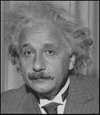
Newton’s 2nd law
There is a mathematical relationship between the resultant force and acceleration.
Resultant force (N) = mass (kg) x acceleration (ms⁻²)
It is also sometimes called the ‘net’ force or ‘unbalanced’ force.
F = ma

Slide 48
An example
What will be Mr Porter’s acceleration?
Mass of Mr Porter and bike = 100 kg
Pushing force (100 N)
Friction (60 N)

Slide 49
An example
Resultant force = 100 – 60 = 40 N
F_{R} = ma
40 = 100a
a = 0.4 m.s⁻²
Mass of Mr Porter and bike = 100 kg
Pushing force (100 N)
Friction (60 N)

Slide 50
Newton’s 3rd law
If a body A exerts a force on body B, body B will exert an equal but opposite force on body A.
Hand (body A) exerts force on table (body B)
Table (body B) exerts force on hand (body A)

Slide 51
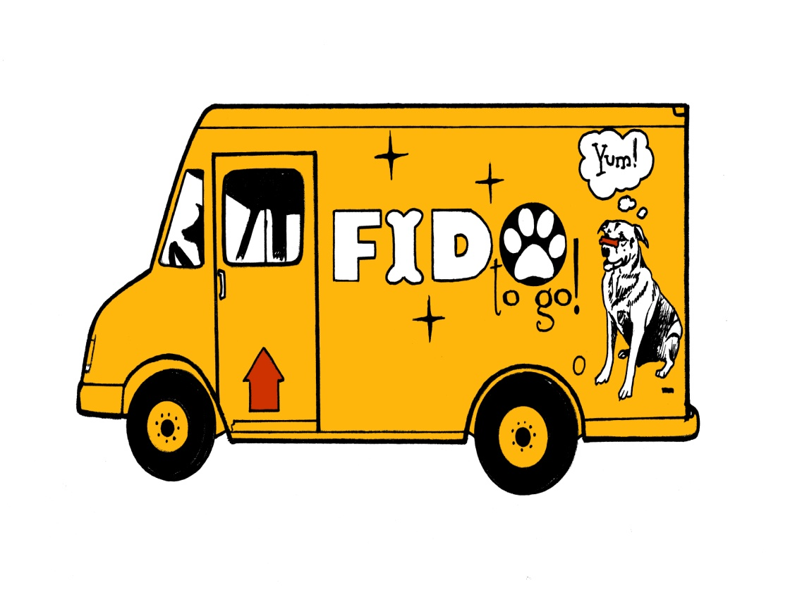
Dog and truck
If a truck hits a dog with a force of 20 00 N, with what force does the dog hit the truck?

Slide 52
Dog and truck
If a truck hits a dog with a force of 20 00 N, with what force does the dog hit the truck?
20 000 N also. Because if body A (the truck) exerts a force on a body B (the dog), than body B (the dog) will exert and equal but opposite force on body A (the truck)

Slide 53
Example question
A force is applied to two masses resting on a frictionless surface as shown. What force does the first mass exert on the second?
20 N
15 kg
10 kg

Slide 54
Example question
Using F = ma for both blocks together
20 = (15 + 10)a = 25a
a = 20/25 = 0.8 m.s⁻²
20 N
15 kg
10 kg

Slide 55
Example question
Looking only at the second block
F = ma = 10 x 0.8 = 8N
20 N
15 kg
10 kg

Slide 56
Let’s try some questions!
2.2 Newton’s law questions

Slide 57
This lesson
Describing solid friction (static and dynamic) by coefficients of friction

Slide 58
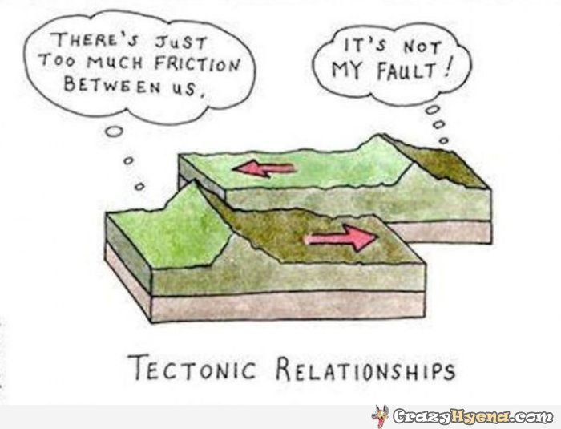
Two types of friction

Slide 59
Two types of friction
Dynamic – when two surfaces move past each other
Static – a tendency to resistance motion between two surfaces

Slide 60
Origin of force
On a very small scale, any surface has irregularities. These collide and give rise to a force that resists the motion

Slide 61
Origin of force
On a very small scale, any surface has irregularities. These collide and give rise to a force that resists the motion

Slide 62
Static friction
Imagine pushing a block

Slide 63
Static friction
If the block doesn’t move, the friction must be equal but opposite to the pushing force.
Friction

Slide 64
Static friction
As you push harder (still not moving), the friction force grows with the pushing force
Friction

Slide 65
Static friction
until……..
Friction

Slide 66
Static friction
until the block just starts to move
Friction

Slide 67
Static friction
The maxiumum friction force at the point just before the block moves is given by the formula F = μ_{s}N
N
Friction
μ_{s} is the coefficient of static friction between the two surfaces and N is the normal reaction force between the two objects

Slide 68
Static friction
In general, including the case where the block does not move
F ≤ μ_{s}N
Friction
μ_{s} is the coefficient of static friction between the two surfaces and N is the normal reaction force between the two objects

Slide 69
Dynamic friction
Once the block is moving, the friction force is less and is given by F = μ_{d}N
Coefficient of dynamic friction
Friction
If the same force is applied that was used to start the block moving, the block now accelerates.

Slide 70
Dynamic friction
Once the block is moving, the friction force is less and is given by F = μ_{d}N
Friction
If the same force is applied that was used to start the block moving, the block now accelerates.

Slide 71
Dynamic friction
Once the block is moving, the friction force is less and is given by F = μ_{d}N
Friction
If the same force is applied that was used to start the block moving, the block now accelerates.

Slide 72
Dynamic friction
Once the block is moving, the friction force is less and is given by F = μ_{d}N
Friction
If the same force is applied that was used to start the block moving, the block now accelerates.

Slide 73
Kinetic/dynamic friction
Once the block is moving, the friction force is less and is given by F = μ_{d}N
Bye!
If the same force is applied that was used to start the block moving, the block now accelerates.

Slide 74
Kinetic/dynamic friction
Once the block is moving, the friction force is less and is given by F = μ_{d}N
If the same force is applied that was used to start the block moving, the block now accelerates.

Slide 75
Static and kinetic/dynamic friction
F ≤ μ_{s}N
If a body touchs another body, there is a force of reaction between the two bodies. This force is perpendicular (normal) to the body exerting the force.
F = μ_{d}N
μ_{s} > μ_{d}

Slide 76
Note
The coefficient of friction depends ONLY on the nature of the two surfaces in contact.
(NOT on surface area)

Slide 77
Example
A dog of mass 4 kg is sitting on a horizontal cliff top. μ_{s} = 0.7 and μ_{d} = 0.3. A horizontal force is provided by a Physics teacher, gradually increasing until the dog starts to move. Find the acceleration of the dog as it start to move.

Slide 78
Example
A dog of mass 9 kg is sitting on a horizontal cliff top. μ_{s} = 0.7 and μ_{d} = 0.3. A horizontal force is provided by a Physics teacher, gradually increasing until the dog starts to move. Find the acceleration of the dog as it start to move.
Weight of dog = mg = 9 x 10 = 90 N
At the point where the dog just starts moving
F = μ_{s}N = 0.7 x 90 = 63 N
As it starts moving, the friction force drops (kinetic friction)
Friction when moving = μ_{d}N = 0.3 x 90 = 27 N
Resultant force just when starts moving = 63 – 27
Acceleration = F_{R}/m = 36/9 = 4 m.s⁻²

Slide 79
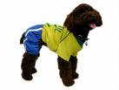
Example

Slide 80
Example

Slide 81
Example

Slide 82
Example

Slide 83
Example

Slide 84
Example

Slide 85
Example

Slide 86
Example
Yummy!

Slide 87
Mass on an inclined plane
Normal reaction force (N)
friction
θ
θ
Physicists luuurve inclined planes.
weight = mg

Slide 88
At the angle that the block just begins to move
Normal reaction force (N)
Friction (μ_{s}N)
θ
θ
weight = mg
Resolving forces parallel to the plane μ_{s}N = mgsinθ
Resolving forces perpendicular to the plane N = mgcosθ
μ_{s}N/N = mgsinθ/mgcosθ u_{s} = tanθ

Slide 89
2.2 using an inclined plane to measure coefficients of static friction

Slide 90
Non-conservative forces
When an object is falling at terminal velocity, the gravitational potential energy is NOT turning to kinetic energy.
We’re not getting faster, so our kinetic energy is not increasing. The gravitational energy is being changed to heat, we are doing WORK AGAINST FRICTION.
GPE lost = work done against friction = force x distance
Why am I smiling so much?

Slide 91
Example
A dog of mass 1.5 kg slides down a road inclined at 30°. After moving very painfully a distance of 2.5 m the speed of the dog is 2.0 m.s⁻¹. What is the coefficient of friction?

Slide 92
Example
A dog of mass 1.5 kg slides down a road inclined at 30°. After moving very painfully a distance of 2.5 m the speed of the dog is 2.0 m.s-1. What is the coefficient of friction?
Initially E = 0J. After moving 2.5m down the plane E_{k} = ½mv² = ½x1.5x(2.0)² = 3 J
Loss of GPE = mgΔh = 1.5x10x2.5sin30° = 18.75 J
Work done by friction force = Loss of GPE – KE = 18.75 – 3 = 15.75 J
Friction force = μ_{k}N = μ_{k}mgcosθ = 13μ_{k}
Work done = Force x distance = 13μ_{k}x2.5 = 15.75
μ_{k} = 0.48

Slide 93
You need to read about this at home don’t you?

Slide 94
2.2 Friction questions

Slide 95
Bye!

